Slide 1
IPv6

Slide 2
IPv6
The network layer protocol in the TCP/IP protocol suite is currently IPv4. Although IPv4 is well designed, data communication has evolved since the inception of IPv4 in the 1970s. IPv4 has some deficiencies that make it unsuitable for the fast-growing Internet.

Slide 3
Internet is growing explosively

Slide 4
Internet is growing explosively
computer, communication, home appliances and entrainment industries are converging
wireless users are increasing
every telephone, TV , appliance in the world may become internet node

Slide 5
Today’s IPv4 will not support this demand
!!!!? Severe scarcity of IP addresses !!!!?
The solution is……………

Slide 6
IPv6
Next generation protocol
to
sustain the growth of internet

Slide 7
IPv6 Goals
Support billions of hosts, even with inefficient address space allocation
Reduce the size of the routing tables
Simplify the protocol, to allow routers to process packets faster

Slide 8
Provide better security ( authentication and privacy ) than current IP
Pay more attention to type of service, particularly for real-time data
Provide multicasting by allowing scopes to be specified
IPv6 Goals

Slide 9
IPv6 Goals
Make it possible for a host to roam without changing its address
allow the protocol to evolve in the future
Permit the old and new protocols to co-exist for years

Slide 10
IPV6 maintains good features of IPV4 ; discards or deemphasizes the bad ones
IPV6 is not compatible with IPV4 , but it is compatible with other auxiliary internet protocols:
    TCP
    UDP
    ICMP
    IGMP
    OSPF
    BGP
    DNS

Slide 11
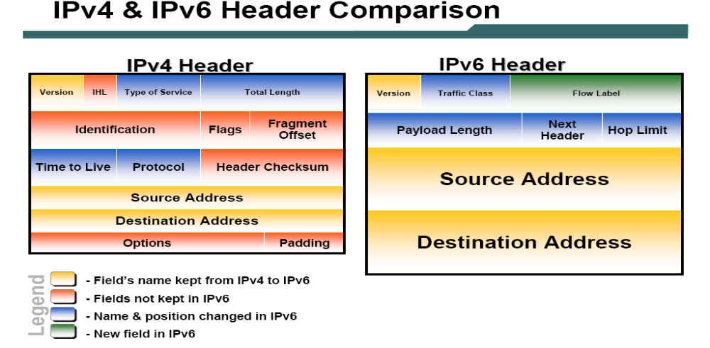

Slide 12

Figure 20.15 IPv6 datagram header and payload

Slide 13
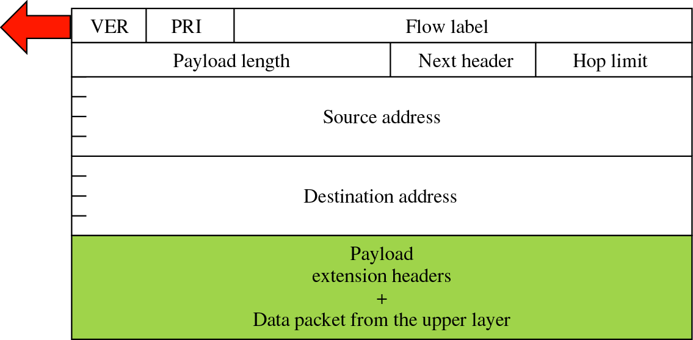
Field –Traffic Class
Traffic Class
PRI
Version number of IP - for IPv6 this value is 6

Slide 14
Field –Traffic Class
PRI
Priority field defines the priority of the packet with respect to traffic congestion

Slide 15
Field –Flow Label
PRI
3 Bytes
To give a special treatment for the packet to set up a flow
An attempt to have flexibility of a datagram subnet and the guarantees of a virtual circuit
to reserve the bandwidth in advance and set an identifier

Slide 16
Field –Pay load length
PRI
3 Bytes
Total length of the IP datagram excluding the base header

Slide 17
Field –Next header
PRI
3 Bytes
an 8 bit field
defines the extension ( optional ) header that follows the base header
  [ There are up to 6 extension headers ]
If this header is the last IP header, this field tells which transport ( upper layer ) protocol handler to pass the packet in [ as in Protocol field in IPV4 ]

Slide 18
Field –Next header
PRI
3 Bytes
Same as TTL in IPv4
Decremented at each hop

Slide 19
Field –Next header
PRI
3 Bytes
16 Byte ( 128 bits ) to identify the source of the datagram

Slide 20
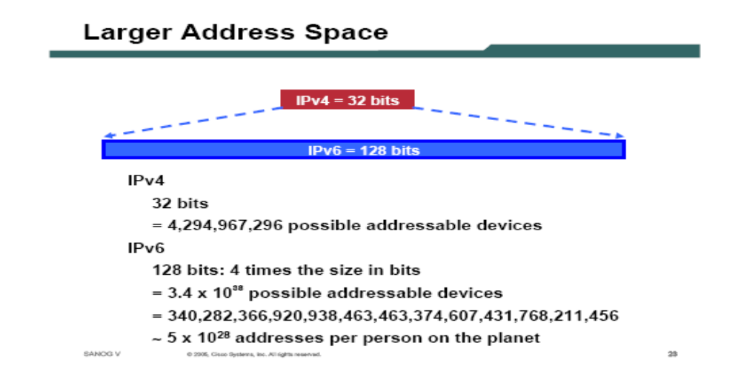

Slide 21
If the entire earth, land and water , were connected with computers,
IPv6 would allow
7 X 10 IP addresses per square meter
23

Slide 22
Field –Next header
Traffic Class
3 Bytes
16 Byte ( 128 bits ) to typically to identify the final destination of the datagram
However, if the source routing is used, this field contains the address of the next router

Slide 23
Format of an IPv6 Datagram

Slide 24
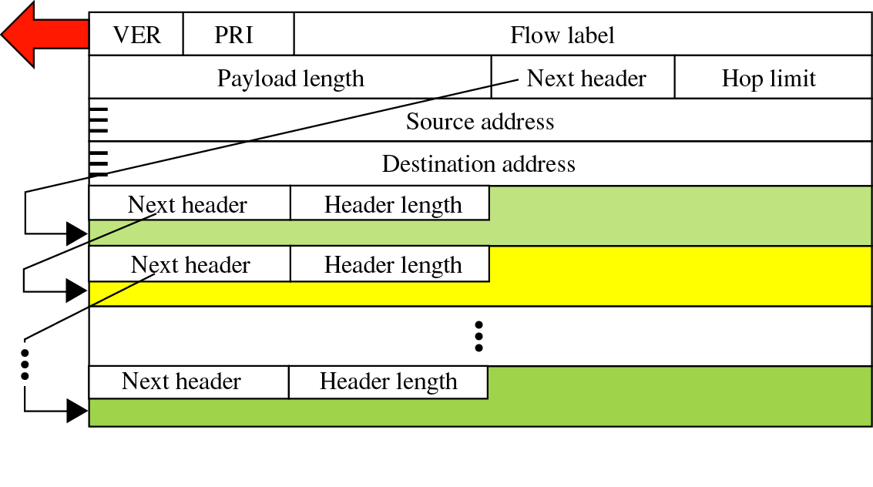
Extension Header Format
optional headers are daisy-chained

Slide 25
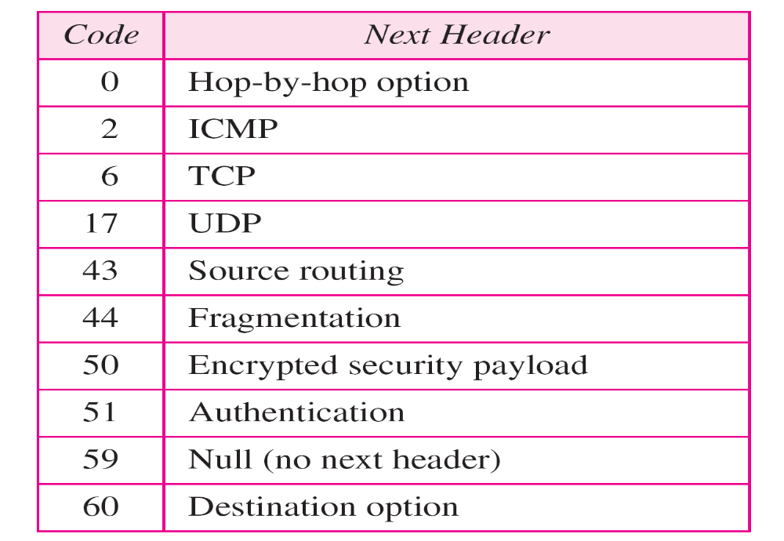
Table 20.6 Next header codes for IPv6

Slide 26
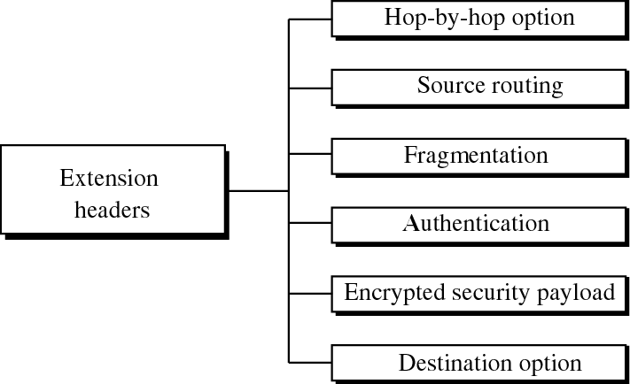
Extension Header
Types

Slide 27
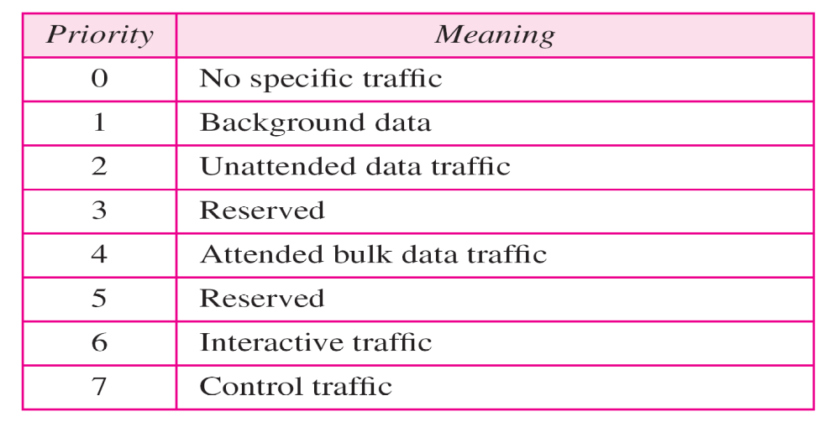
Table 20.7 Priorities for congestion-controlled traffic

Slide 28
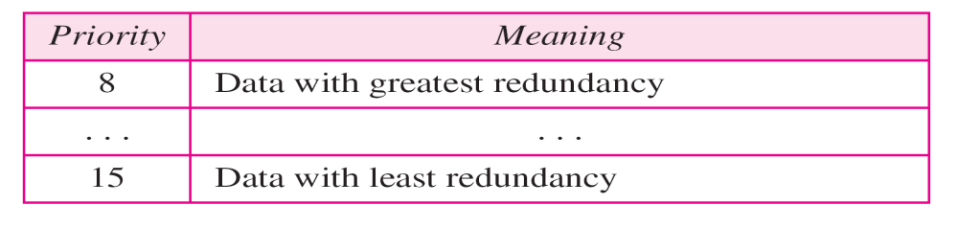
Table 20.8 Priorities for noncongestion-controlled traffic

Slide 29
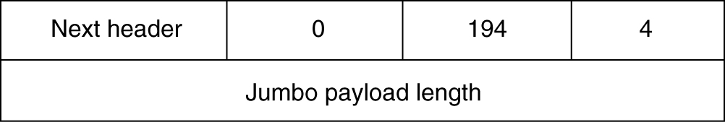
Extension Headers
The hop-by-hop extension header for large datagrams (jumbograms).

Slide 30
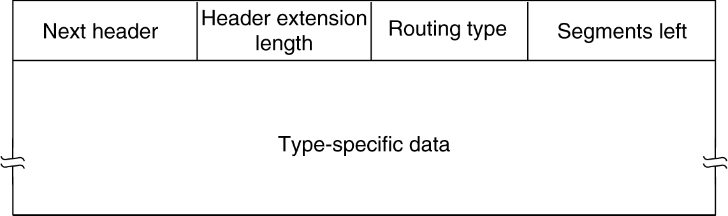
Extension Headers
The extension header for routing.

Slide 31
Advantages of IPv6 over IPv4
Larger address space
Better header format
New options
Allowance for extension

Slide 32
Advantages of IPv6 over IPv4
5.Support for resource allocation
6.Support for more security

Slide 33
What has been left out in IPv6 compared to IPv4 ?
1. IHL field
Because IPv6 has a fixed length
2. Protocol field
The Next Header field takes care of this
3. All fields related to fragmentation
IPv6 takes different approach to fragmentation
4. Checksum field
assumed that physical layers are more reliable
assumed that data link layer and transport layer will take care of this
to increase the performance

Slide 34
IPv6 approach for fragmentation
Hosts are expected to dynamically determine the datagram size to use; hence fragmentation is less likely to occur
Minimum datagram size is raised to allow 1280 bytes
If a host sends a large packet, instead of fragmenting the router that is unable to forward sends back an error message. This message instructs the host to break up all future packets

Slide 35

Table 20.9 Comparison between IPv4 and IPv6 packet headers

Slide 36

Figure 20.17 Extension header types

Slide 37
Table 20.10 Comparison between IPv4 options and IPv6 extension headers

Slide 38
20-4 TRANSITION FROM IPv4 TO IPv6
Because of the huge number of systems on the Internet, the transition from IPv4 to IPv6 cannot happen suddenly. It takes a considerable amount of time before every system in the Internet can move from IPv4 to IPv6. The transition must be smooth to prevent any problems between IPv4 and IPv6 systems.
Topics discussed in this section:
Dual Stack
Tunneling
Header Translation

Slide 39

Figure 20.18 Three transition strategies

Slide 40

Figure 20.19 Dual stack

Slide 41

Figure 20.20 Tunneling strategy

Slide 42

Figure 20.21 Header translation strategy

Slide 43
Table 20.11 Header translation

